Slide 1

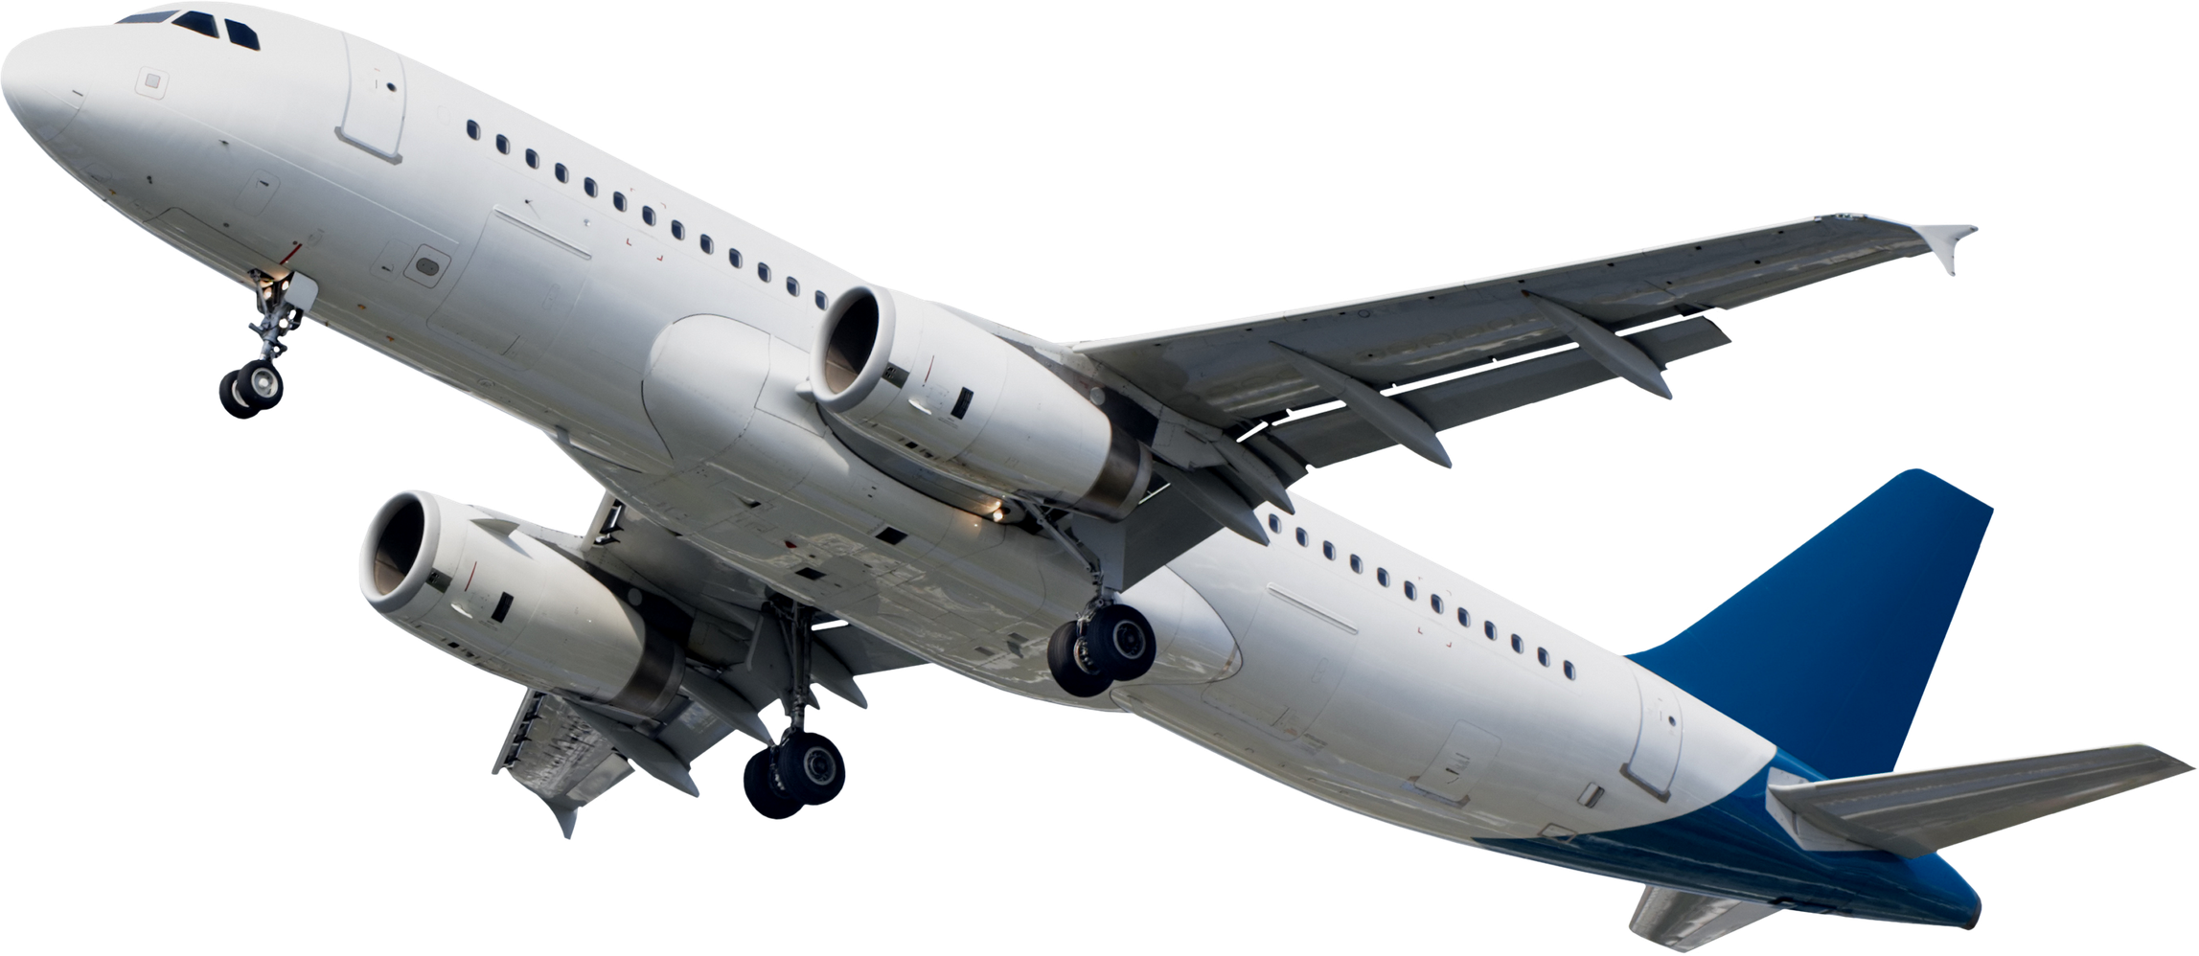
AeroNova
Home
About Us
Service
Contact
Search. . .
WELCOME TO THE
A Gateway To Every Journey
An airport connects travelers with destinations through organized services, convenient facilities, clear information, and a smooth journey from arrival to departure.
AIRPORT
START YOUR JOURNEY

Slide 2
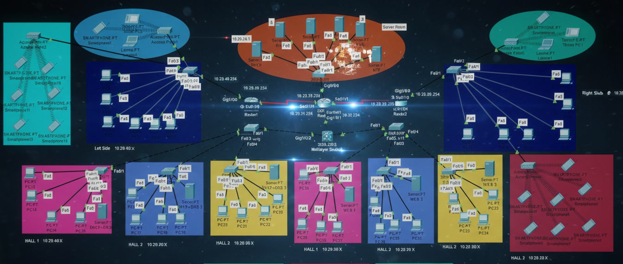
AeroNova
Home
About Us
Service
Contact
Search. . .
AIRPORT NETWORK TOPOLOGY

Slide 3

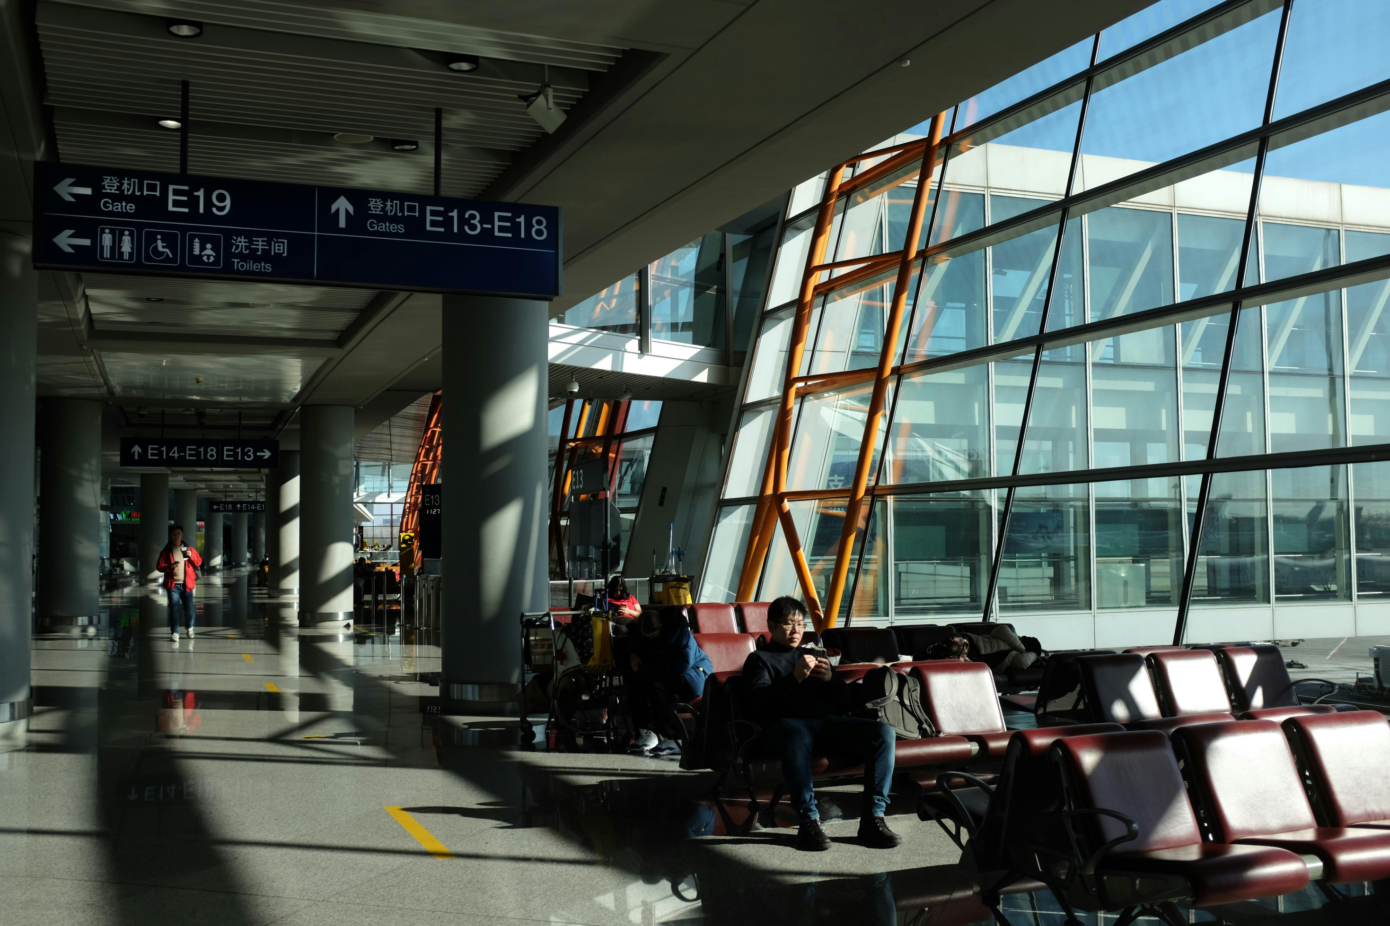
AeroNova
Home
About Us
Service
Contact
Search. . .
INSIDE THE
Server’s Room
Centralized infrastructure providing essential network services and hosting the main servers.
AIRPORT
Left Side Management
Provides network connectivity and management for administrative devices on the left side.
Right Side Management
Provides network connectivity and management for administrative devices on the right side.
VLAN Halls
Segments each airport hall into separate VLANs to improve network organization, isolation, and traffic management.

Slide 4
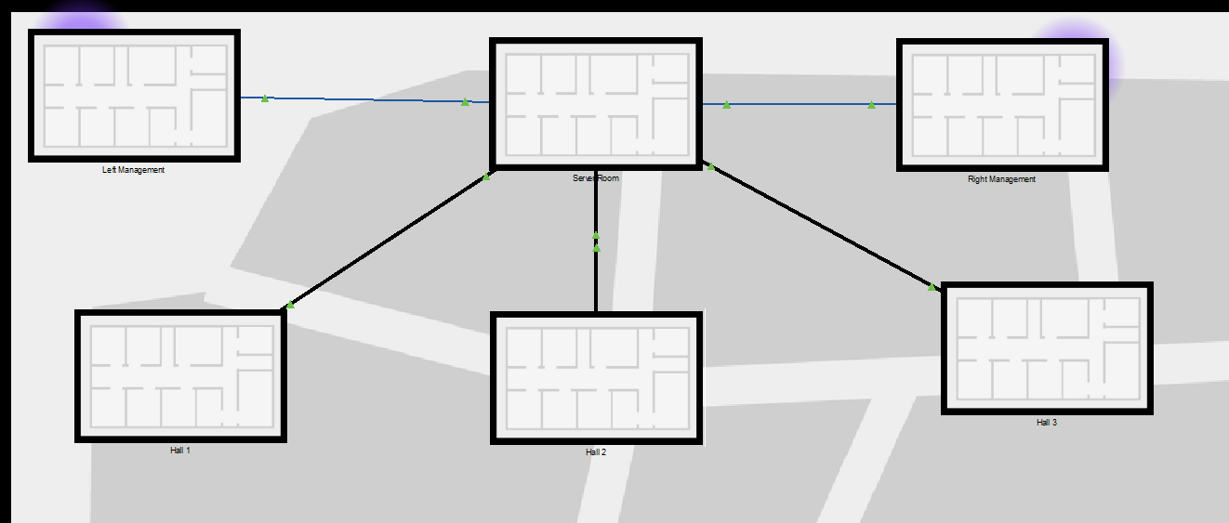
AeroNova
Home
About Us
Service
Contact
Search. . .
PHYSICAL TOPOLOGY

Slide 5
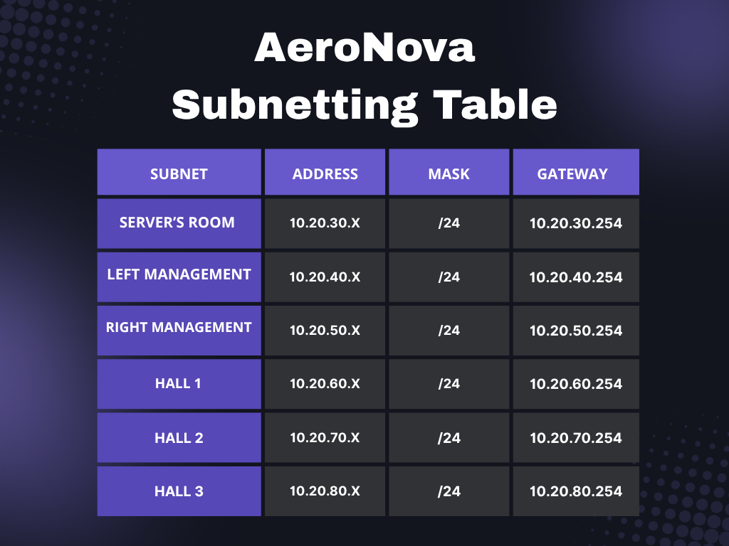
AeroNova
Home
About Us
Service
Contact
Search. . .
ADDRESSING TABLE
This addressing scheme was chosen for its logical, scalable, and secure design. It uses the private 10.20.x.x range with a consistent /24 subnet mask, which provides 254 usable addresses per location—enough for a room full of devices while keeping traffic manageable.
The core strategy is using the third octet as a location identifier.

Slide 6
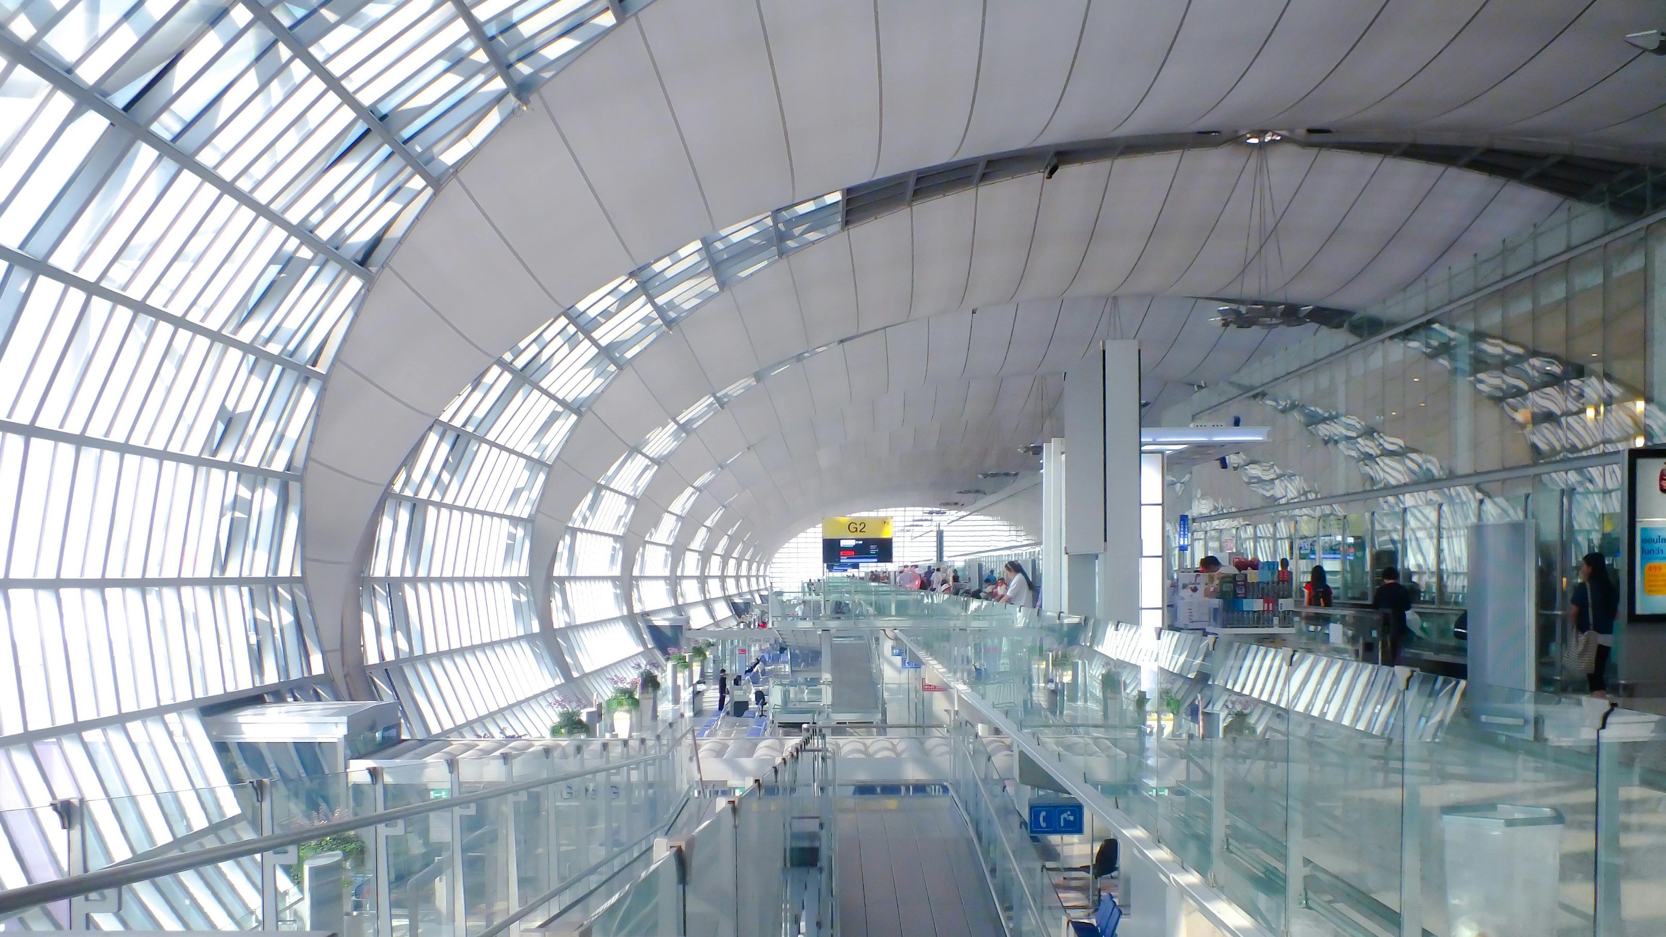
AeroNova
Home
About Us
Service
Contact
Search. . .
ESSENTIAL NETWORK
SERVICES
Dynamic Addressing
DNS & Web Hosting
FTP & Email Services
NTP Server
  The DNS Server translates domain names into IP addresses, while the Web Server hosts the AeroNova website and allows users to access it through web browsers.
  The FTP Server provides secure file transfer and sharing between users, while the Email Server enables users to send and receive emails.
  Synchronizes the date and time of network devices, ensuring accurate timestamps for logging, monitoring, troubleshooting, and security events.
  The DHCP Server automatically assigns IP addresses and other network configuration parameters such as the subnet mask, gateway, DNS server.

Slide 7

AeroNova
Home
About Us
Service
Contact
Search. . .
SECURITY IMPLEMENTATIONS
We applied SSH on the Backbone Router.
Encrypted remote management — replaced Telnet with SSH.
Configured RSA keys, local admin user, and transport input ssh on VTY lines.
Result: Secure admin access to the core router.
We also applied an ACL on a PC in the Left Side Management.
Located at 10.20.40.x — policy enforced at the gateway (Router1).
Denied: Access to Web Server (10.20.30.3).
Permitted: Server Room (10.20.30.0/24) and Right Management (10.20.50.0/24).
Implicit deny-all at the end.

Slide 8
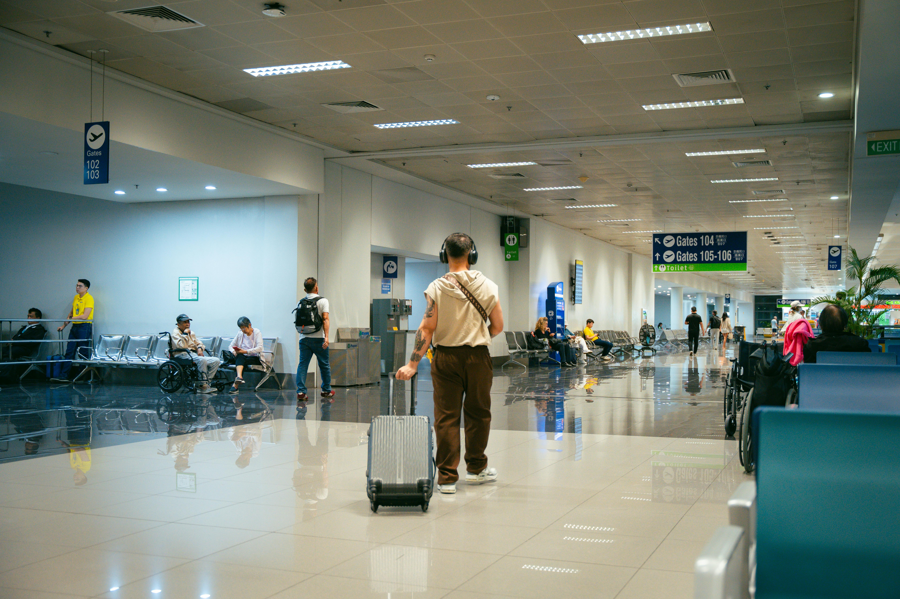
AeroNova
Home
About Us
Service
Contact
Search. . .
WIRELESS CONNECTIVITY
01.
Management Subnets
02.
Smart Area 1 & 2
  Wireless access provides flexible and reliable connectivity for management staff and authorized devices, allowing them to access internal network resources without relying entirely on wired connections. It supports staff mobility across different areas while maintaining access to essential management services.
  These areas provide wireless connectivity for the large number of mobile phones used by the security team.
Security Team Communication
  The wireless network enables security personnel to communicate quickly and coordinate across different areas of the airport.
03.
Mobility
  Wireless connectivity allows security staff to remain connected while moving between halls and different airport areas.

Slide 9
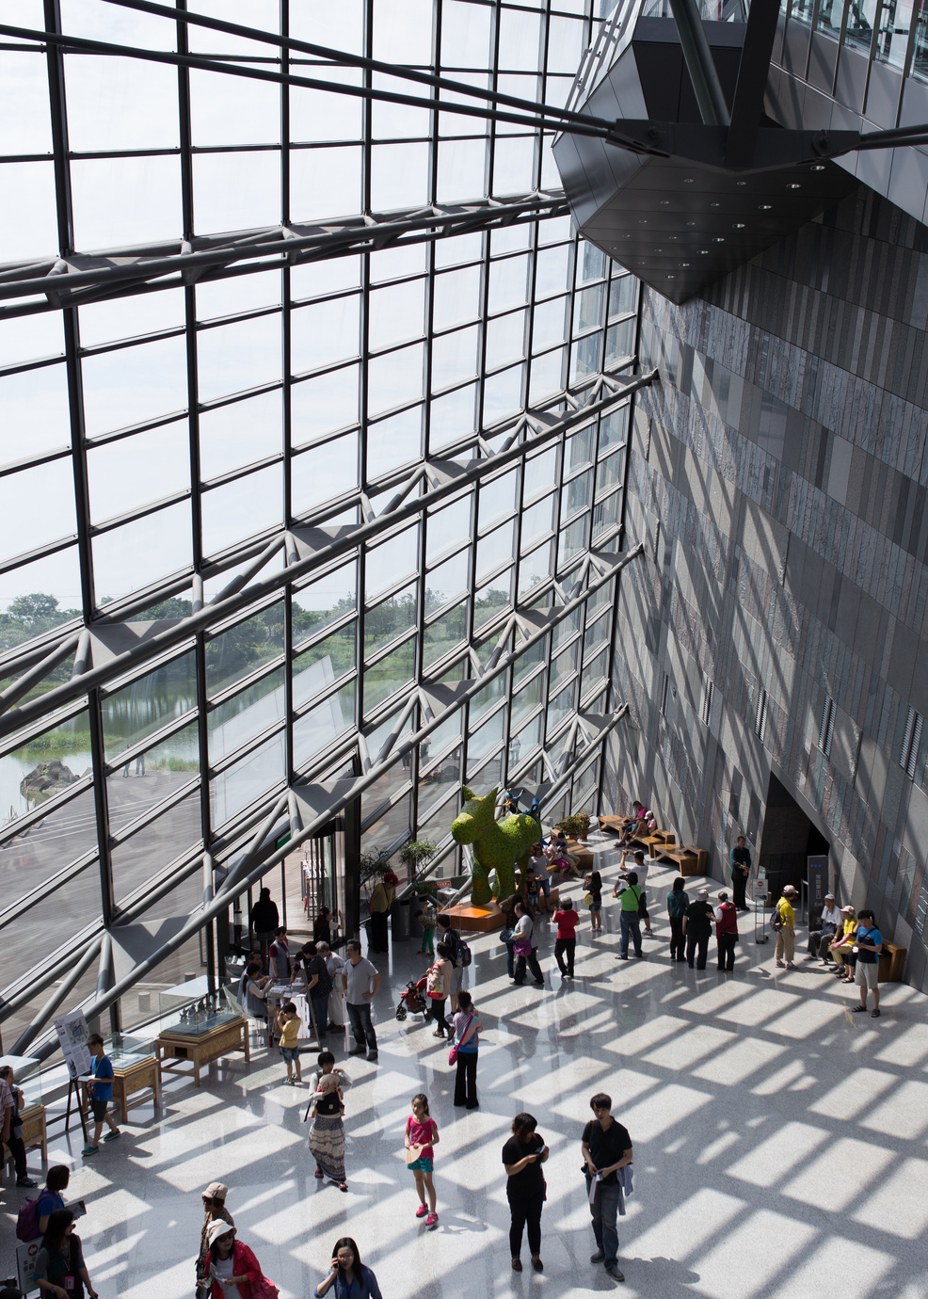
AeroNova
Home
About Us
Service
Contact
Search. . .
HALL WEB SERVERS & INTER-VLAN ROUTING
  Each airport hall is assigned to a separate VLAN and has its own dedicated Web Server that hosts the website and flight information specific to that hall. The Multilayer Switch provides Inter-VLAN Routing, allowing users from different Hall VLANs to communicate with and access the Web Servers of other halls when needed, while keeping each hall logically separated. This design provides both network segmentation and seamless communication between the different halls and their services.

Slide 10
AeroNova
Home
About Us
Service
Contact
Search. . .
EVERY JOURNEY STARTS
HERE
Travel With Confidence
An airport connects travelers with destinations through organized services, convenient facilities, clear information, and a smooth journey from arrival to departure.
END OF PRESENTATION

